Slide 1
REAL TIME SIGN LANGUAGE DETECTION AND RECOGNITION
BY-
Sambodhi umare

Slide 2
INTRODUCTION
Sign language is a mode of communication like expressions, hand gestures to convey meaning.
It is extremely useful for people the face difficulty with hearing or speaking.
Hand and facial parts are immensely influential to express the thoughts of human in confidential communicaton.
This model helps to bridge this gap by taking expressions and hand gestures from people and presenting a text recognized output .

Slide 3
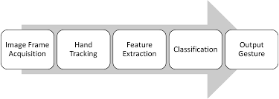
BLOCK DIAGRAM

Slide 4
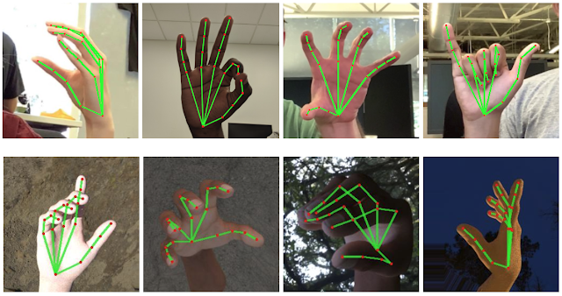
WHAT IS HAND POSE RECOGNITION?
Machine learning technique that detects different points
on your hand
These points are commonly referred to as landmarks.
The hand pose model that’s being used is provided by
mediapipe and detects different points in your hand

Slide 5
MEDIAPIPE
Media Pipe is a cross-platform (Android, ios,web) framework used to build Machine Learning pipelines for audio, video, time-series data etc.
Mediapipe is a framework used to build Machine Learning Pipelines.
It works on many different solutions like Face Detection, Hands, Object Detection, Holistic, Face Mesh, Pose, etc.
MediaPipe Hand is a machine-learning employed high-fidelity hand and finger tracking solution. It detects 21 Landmark points as shown in Fig. are recorded from a hand in a single frame with the help of multiple models which are working simultaneously.

Slide 6
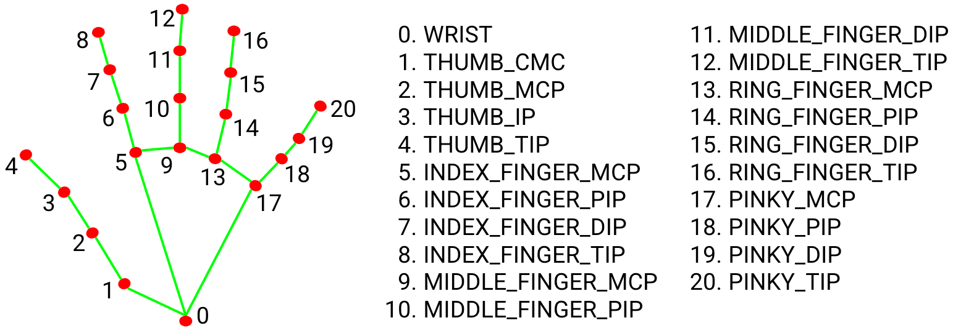
HAND LANDMARKS

Slide 7
WORKING
Hand Tracking
Hand Landmark Detection
Get each hand Landmark actual pixel position
Highlight finger tips
Check if fingers are folded
Track thumb position
Identify signs
Detect signs in realtime.

Slide 8
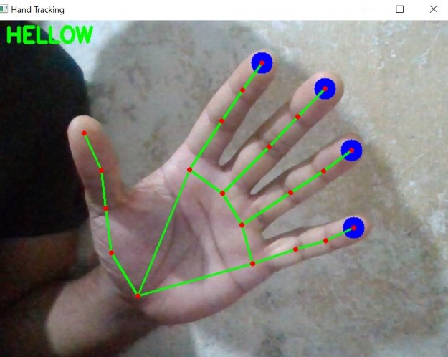
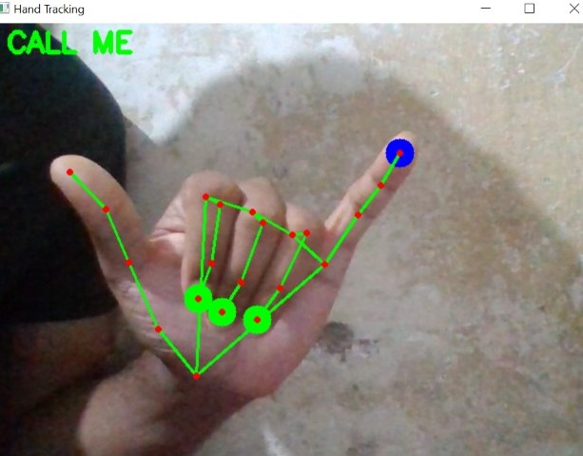
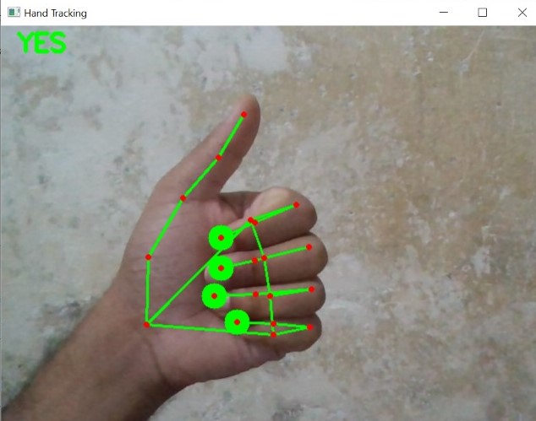
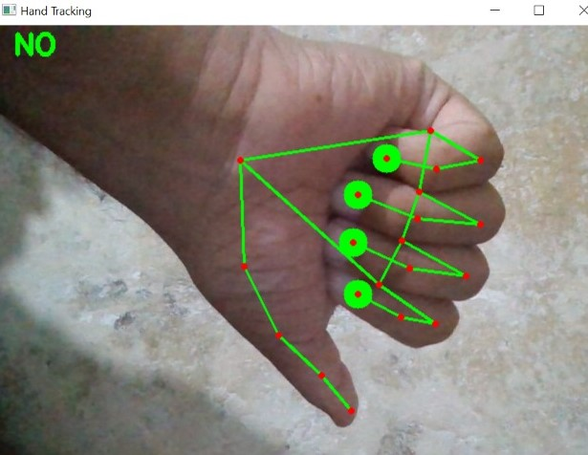
OUTPUT

Slide 9
THANK YOU

